Slide 1
Staff Support Pack
#BeeWell HIPS 2026-2027

Slide 2

Contents & Resources
Contents
About #BeeWell
What's new since #BeeWell launched?
Session plan
Supporting pupils with additional needs
Signposting to support
Distress protocol
Staff FAQs
Pupil FAQs
Glossary
Resources
Survey (PDF)
Introducing the survey (presentation slides)
Support poster (PDF)
Distress protocol (PDF)

Slide 3

Designed by young people, #BeeWell is surveying the wellbeing of young people across Hampshire, Isle of Wight, Portsmouth and Southampton. Since 2023, we've listened to the voices of almost 63,000 young people, working with around 115 schools.
The results are being used to deliver positive change in schools and communities.
About #BeeWell

Slide 4
Key information on delivering survey
We will continue to survey Year 7 and Y10 pupils for the fourth year running. This year we start our new three year #BeeWell cycle. Special schools, alternative provisions and pupils referral units can opt to survey additional year groups. Contact HIOW.BeeWell@hants.gov.uk to discuss this further.
The parent/carer opt-out forms must be sent out before 16th September. The survey window will begin on Monday 12th October and close on Friday 27th November. The PRUs and APs will be provided a two week extension, with the survey window closing on Friday, 11th December.
We have made some changes to the #BeeWell survey questions this year following the consultations with Y7/8 pupils and wider stakeholders across the HIPS. You can find out about the most recent changes, here:#BeeWell HIPS Survey 2026
Non-mainstream settings can decide which of the three surveys would be most appropriate for your pupils to take part in. Additional two survey versions are here: Short survey: HIPS #BeeWell SHORT SURVEY 2026 Symbol survey: HIPS #BeeWell SHORT SURVEY 2026
Increased support for DSA completion: Independent and non-mainstream schools will be contacted by the #BeeWell Team to agree a Data Sharing Agreement, to ensure that pupil information is as up to date as possible for survey delivery.

Slide 5
Session plan
Aims Pupils to understand the background of the research. Pupils to understand why they are being asked to complete the survey. All pupils with parental consent have the opportunity to complete the online pupil survey.
Setting up the classroom:
Each pupil will need their own computer or laptop in order to complete the survey (ideally these will be spaced out so that pupils cannot see each other’s responses).
Ensure that you have the correct survey passwords for your class – every pupil will have their own individual password provided to you by the #BeeWell team.
Check that the survey link works on your school's computers
Familiarise yourself with the survey questions.
NOTE: Make sure you have an activity planned for any pupils who will not be taking the survey/those who finish early.

Slide 6
 | Key Points/Notes | Resources
Introducing the research & survey | Tell the pupils that the school is taking part in the #BeeWell Programme Researchers want to understand more about young people’s mental health and wellbeing (see Glossary for definitions), and the factors that influence these. Please clarify that the survey is: an online survey about different aspects of their lives not a test completely anonymous – parents and teachers will not see any answers Ask the pupils if they have any questions about the survey. Highlight who pupils can talk to if they think they need some help or support. Work through two example questions with the pupils to help them to understand how the questions work. Encourage young people hover over definitions if they are unsure on the meaning of a particular word. | Year 7 presentation slides Year 10 presentation slides Introduction to #BeeWell video Glossary (Slides 14-16 of this PowerPoint)
Pupils completing the survey | Each pupil has a unique password that will allow them access to the survey. Reiterate that pupils should not be looking at each other’s answers. | Pupil FAQs (Slides 12-13 of this PowerPoint) Staff FAQs (Slides 10-11 of this PowerPoint) Glossary (Slides 14-16 of this PowerPoint)
Summary | Reiterate that the survey is anonymous, and no teachers or parents will be able to see the answers – highlight once again the people in the school that pupils can talk to. Ask the pupils for any questions that they may have about the survey, now that they have completed it. | None

Slide 7
Supporting pupils with additional needs
Principles:
We want everyone to have the support they need to enable them to take part.
You are the experts, your staff know your pupils best and so you are best placed to know how each young person is best supported.
As far as possible, support should align with usual practice in your setting.
Plan ahead to ensure support is available.
Support could include:
Reading the text to the young person.
Explaining words and concepts to help them understand. Various questions in the survey will have a hover over function with further information and definitions to assist young people in answering the question.
Providing breaks (the survey can be completed in multiple sittings).
Do try to provide some privacy when the young person is choosing their response – this can be as simple as looking away.
More information can be found in Staff FAQs and Pupil FAQs

Slide 8
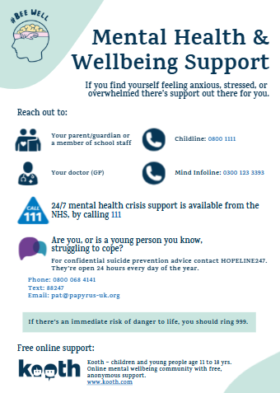
Signposting to support
Most pupils will cope well with completing the survey
For some, however, it may raise issues for which they may benefit from support
A poster is provided to be displayed both in the room and other places where participants may see it.
The poster signposts to sources of support, we suggest also making participants aware of in-school support
It is possible that a young person becomes distressed during the session. If this happens then the ‘distress protocol’ needs to be followed (more information overleaf and enclosed as a PDF).

Slide 9
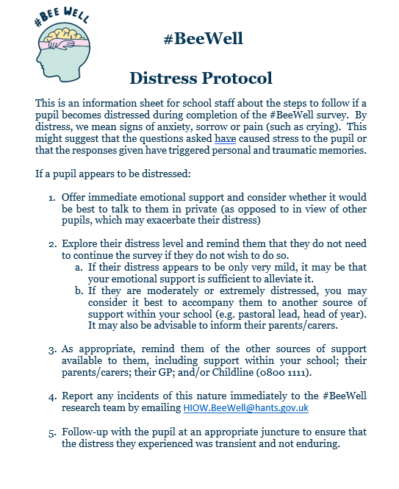
Distress protocol
This is an information sheet for school staff about the steps to follow if a pupil becomes distressed during completion of the #BeeWell survey. By distress, we refer to signs of anxiety, sorrow or pain (such as crying). This might suggest that the questions asked have caused stress to the pupil or that the responses given have triggered personal and traumatic memories.

Slide 10
Staff FAQs
I’m worried that some of the young people may find the questions hard to understand. How can I help?
Sometimes pupils may find some of the survey questions abstract and struggle to imagine certain scenarios. Hopefully, the examples on the PowerPoint will help your pupils understand what they need to do. If they are still struggling with individual questions, you could try to offer them other examples (e.g., ‘Imagine you came out from class late and you are alone, will xx ask you to join in?’).
My pupils work at very different speeds. How should I manage this?
Some pupils will work through the survey very quickly. This is why we recommend having a task ready for early finishers that won’t disturb others who are finishing the survey. Some pupils may find it harder to understand the survey questions and will take a little longer. It is important that you allow them time and space to understand the questions and offer a helping hand only when asked. In our experience, almost all pupils can complete the survey within 30 minutes, with an average survey completion time in 2024 of 22 minutes for those in Year 10 and 26 minutes for those in Year7. Despite this, pupils should be provided with a full lesson to complete the survey, to ensure everyone has time to take part.
One of my pupils finds it hard to concentrate for more than a few minutes. How can I support them to finish the survey?
If you predict that some pupils may find it difficult to concentrate for the duration of the survey, then make appropriate arrangements for rest breaks. A young person can take as long as they need to complete the survey, though ideally it will be completed in one sitting.
Continued…

Slide 11
Staff FAQs continued
One of my pupils finds it difficult to read small print on screen. Can the text be made larger?
Pupils can zoom in by pressing “Ctrl + plus sign” and zoom out by pressing “Ctrl + minus sign”.
Some of my pupils have reading difficulties. How can I help them answering the questions in the survey?
To help pupils with reading difficulties or special educational needs, you may want to have a print-out of the survey and read the questions for them (or have a teaching assistant or learning mentor do this with them). If this is the chosen option, please support pupils in understanding the question but make sure they are given space to select their answer privately (e.g., look away or move away).
My pupils find it hard to choose how to respond. How should I support them?
Remind them that the response options range in severity and talk through the scales with them (i.e. from disagree to agree or from never to always). Certain questions also now include hover overs with further information or definitions to help pupils answer questions. These were informed by consultation with Year 7 pupils and school staff.
If you have additional questions, do email the #BeeWell Team: HIOW.BeeWell@hants.gov.uk

Slide 12
Pupil FAQs
Why am I being asked to fill in this survey?
This will help us to learn about young people’s mental health and wellbeing. It will help the research team and your school to find out what things make young people more likely to have good mental health and emotional wellbeing.
Will the survey affect us?
Answering the survey won’t have immediate effects on you, however, we hope that the survey will help your school and the researchers to learn about how to improve support for young people’s mental health and wellbeing.
Who will see the answers I give?
The survey is anonymous. This means no one at your school, or your parents, will know what individual answers you gave. Your answers go to the research team only. They put all young people’s answers together in a project file so that they can learn about how young people are feeling across the Hampshire, Isle of Wight, Portsmouth and Southampton (HIPS). Although the research team may share the project file with others (e.g. other researchers, people at local authorities in HIPS), it will not contain any information that would let people know who you are (for example, your name).
As no one in your school will see your answers, if you need to talk to someone about your feelings, you can speak to a teacher or another adult you trust in school.
Continued…

Slide 13
Pupil FAQs continued
Is the project just for young people with problems or for everyone?
This project is for all young people. We all need to look after our mental health and wellbeing, just like we need to look after our physical health.
Some of the questions are very similar – is that a trick?
Some questions may sound very similar, but it’s not a trick. Some questions may ask the same thing in different ways so that we can make sure we really understand how young people are feeling.
Is this a test?
No, this isn’t a test. There are no right or wrong answers. The questions in the survey are just about your thoughts and feelings.
Do I have to answer every question?
If you don’t want to answer a question, that’s ok. It’s your choice which questions you answer. If you don’t want to answer a question, just leave it blank and move onto the next one.
Why am I being asked about different aspects of my life that I don't think relates to my wellbeing (e.g., sexual orientation or migration)?
Your wellbeing is influenced by many different factors- such as your background, identity, family, and life experiences. These factors can shape young people's feelings and experiences. By asking these questions, we can better understand and support the wellbeing of all young people.
If you have additional questions, do email the #BeeWell Team: HIOW.BeeWell@hants.gov.uk

Slide 14
Glossary
A to G
Abusive – Treating someone badly or cruelly.
Anonymous - Not named or identified.
Abilities – The power or skill to do something.
Bullying – Bullying is when someone is being hurt by words or actions on purpose, usually more than once, feels bad because of it, and has a hard time stopping what is happening to them.
Cyberbullying – Bullying (see above) that takes place online. For example, on social media, texts, email, posts, or other digital methods.
Confident - Feeling or believing that you can do something well.
Cope - To deal with or handle problems.
Disability - A physical or mental condition that limits a person’s movements, senses, or activities.
Emotions - Emotions are the way you feel. For example, feeling happy or sad.
Express - To show how you think or feel.
Extent “Indicate to what extent” - How much.
Job prospects - How likely you are to be successful in a future job.
Gender - Gender refers to the characteristics (for example, behaviours) that different cultures and societies associate with girls and boys (or men and women).
Gender Identity - A person’s innate sense of their own gender, whether male, female or something else, which may or may not correspond to the sex assigned at birth. For example, someone assigned male at birth may identify as a girl, or indeed not identify with any particular category.
Generally/In general - In most cases/ most of the time.
Generation - A group of people born and living at about the same time.

Slide 15
Glossary
I to S
Interactions – The act of meeting, talking, or doing things with someone.
Lonely - The unhappy feeling of being alone or apart from others.
Mental health - We all have mental health. Mental health is about our feelings, our thinking, our emotions and our moods.
Mental health condition - Refers to a particular type or state of mental health, for example, depression, anxiety, schizophrenia.
Mildly “I mildly disagree” - I disagree a little bit.
Moderately “I moderately disagree” - I disagree quite a bit.
Neighbours - The people who live in the houses close to your house.
Optimistic - Believing that good things will happen.
Physical Activity - An activity that increases your heart rate and makes you get out of breath.
Physical Health - How well your body functions physically.
Pressured - Feeling like you have to do something you don’t want to do.
Qualities “I feel that I have a number of good qualities” - Things that you like about yourself.
Rarely - Not very often, hardly ever.
Research - A study of data or information.
Satisfied - Feeling pleased with the way things are.

Slide 16
Glossary
S to W
Self-Esteem - Self-esteem means you mostly feel good about yourself. Low self-esteem means you don’t feel very good about yourself.
Several – Greater than two, but not that many.
Sexual Orientation - Sexual orientation is a term to describe a person’s sexual attraction to other people. These terms refer to a person’s sense of identity based on their attractions, or lack thereof.
Responses include:
Bi/Pansexual (a person who is attracted to more than one gender/a person whose attraction towards others doesn’t regard sex or gender.)
Gay/Lesbian (a person who is attracted to other people of the same gender/a woman who is attracted to other women)
Heterosexual/straight (a person who is attracted to people of a different gender).
Transgender: Someone who was assigned male at birth but is a girl, or someone who is non-binary and is not a girl or a boy.
Value - “I am a person of value” - A feeling of importance, worth and/or usefulness.
Wellbeing - A state of being comfortable, healthy and happy. This includes both physical and mental wellbeing which are equally important.

