Slide 1
#BeeWell 2026/27
Schools Kick-off Session
Greater Manchester
beewell@manchester.ac.uk

Slide 2
Agenda
What is #BeeWell? Refresher
The Role of the #BeeWell Lead
Timeline for this year & the survey delivery process
Bespoke offer for alternative provisions, pupil referral units and special schools
Any questions?

Slide 3
Housekeeping
We will be recording today's session and to add this to our website. We will continue to record in the questions section of the session, but that is just so we can follow-up with you offline if needed – we won't add that section of the recording to the website.
Feel free to turn your camera on or off – whatever you prefer.
Please keep your mic off if you're not speaking, but feel free to raise your hand and ask a question at any point during the presentations.

Slide 4

What is #BeeWell?
#BeeWell is a youth-centred programme seeking to make young people’s wellbeing everybody’s business.
We believe that young people’s wellbeing is as important as their academic attainment. Using a co-designed survey, we listen to the voices of as many young people as possible, publish the results privately to schools and publicly by neighbourhood and drive action across society to improve young people’s wellbeing.
#BeeWell’s three main principles are to:
Listen to young people’s voices
Act together for change
Celebrate young people’s wellbeing
In five years, #BeeWell GM has heard from more than 140,000 young people, from 210 secondary schools.

Slide 5

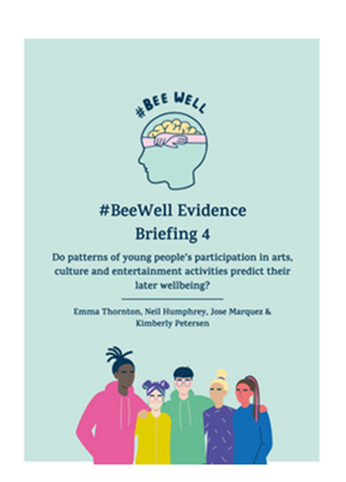
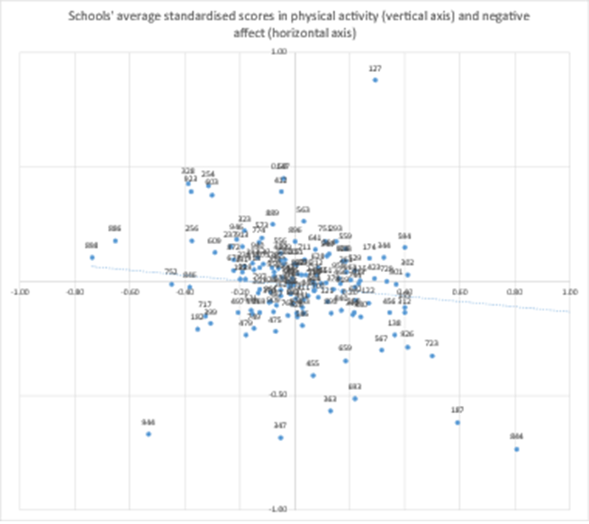
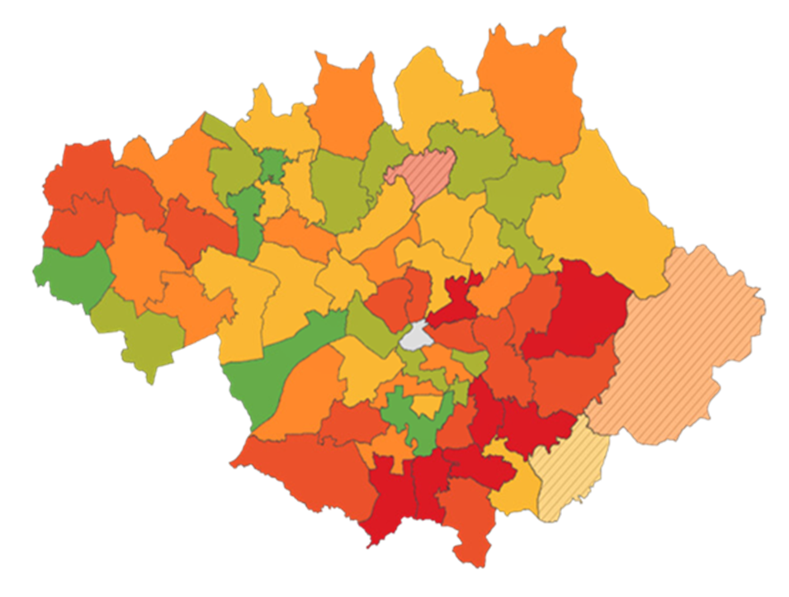
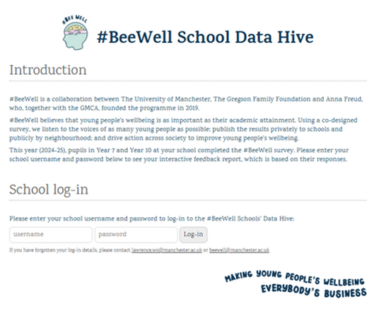
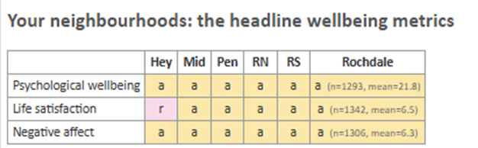
What happens with the #BeeWell survey responses?
Thematic reports and briefings
Bespoke data cuts
Neighbourhood dashboard, using home postcode. Publicly available
Greater Manchester #BeeWell Reports & Briefings - #BeeWell (beewellprogramme.org)
Submit requests via the #BeeWell data requests form.
www.uomseed.com/beewell-gm-neighbourhoods/
Confidential school dashboards
Provided to schools by February 2027
Locality 'at a glance' dashboards
Password required. www.uomseed.com/beewell-gm-locality/

Slide 6
What can I use the dashboard data for?
Identify what's going well and priority areas
Use your summary data to identify overall areas of strength and challenge by year group.
Triangulate this with other sources of information.
Track change over time
Track changes over time using longitudinal snapshot data.
Track changes for specific cohorts as they get older using the longitudinal tracker data.
Explore differences and inequalities
Use subgroup comparisons to explore differences and whether they are statistically significant.
You can also use filters and the comparison page.
Compare your school's data to similar/all schools
Comparisons are available on this year's data and longitudinal data. Use this to contextualise your school's data.

Slide 7
Impact & Influence
YOUNG PEOPLE
SCHOOLS
  Leading responses to their local #BeeWell data, including artistic responses, creating videos, campaigns to raise awareness on key findings and much more.
  Launching the everyday success project, using the data to explore what success means in GM.
  Writing articles to support other young people.
  Becoming #BeeWell Champions &
commissioning almost £100k
  Analysing research from the #BeeWell data.
  Sharing findings with councils & politicians..
#BeeWell provides schools with bespoke dashboards and one to one support to focus their wellbeing initiatives where its needed most, examples of schools acting on their data include:
  Improving staff/pupil relationships.
  Develop culture opportunities available to young people.
  Focussed support for year groups identified in the data.
  Responding to discrimination.
  Sharing learning with other #BeeWell schools on key themes, for example school belonging.
  The Greater Manchester Strategy outlines how
the city-region will act upon #BeeWell insights.
  Supporting SEND Ofsted inspections.
  Embedding data into needs assessments for youth services.
  GM Police and Crime Plan: Standing Together uses #BeeWell insights.
  Raising Rochdale Children & Young People’s Partnership Plan.
  Wigan Youth Cabinet lead action on the #BeeWell data in their local area.
  Trafford Council have detailed how they are acting upon the data in a ‘You Said, We Did’ resource to young people.
We have over 100 Coalition Partners committed to improving wellbeing. Actions taken include...
  A successful bid to create a community library in Salford.
  A campaign looking at physical activity and wellbeing.
  Leveraged investment into Youth Alliance GM to coordinate response.
  School projects on wellbeing and arts, with Curious Minds & Company Chameleon.
  A community of practice to support organisations working with young people.
LOCAL GOVT & HEALTH SYSTEM
COALITION OF PARTNERS

Slide 8


Slide 9
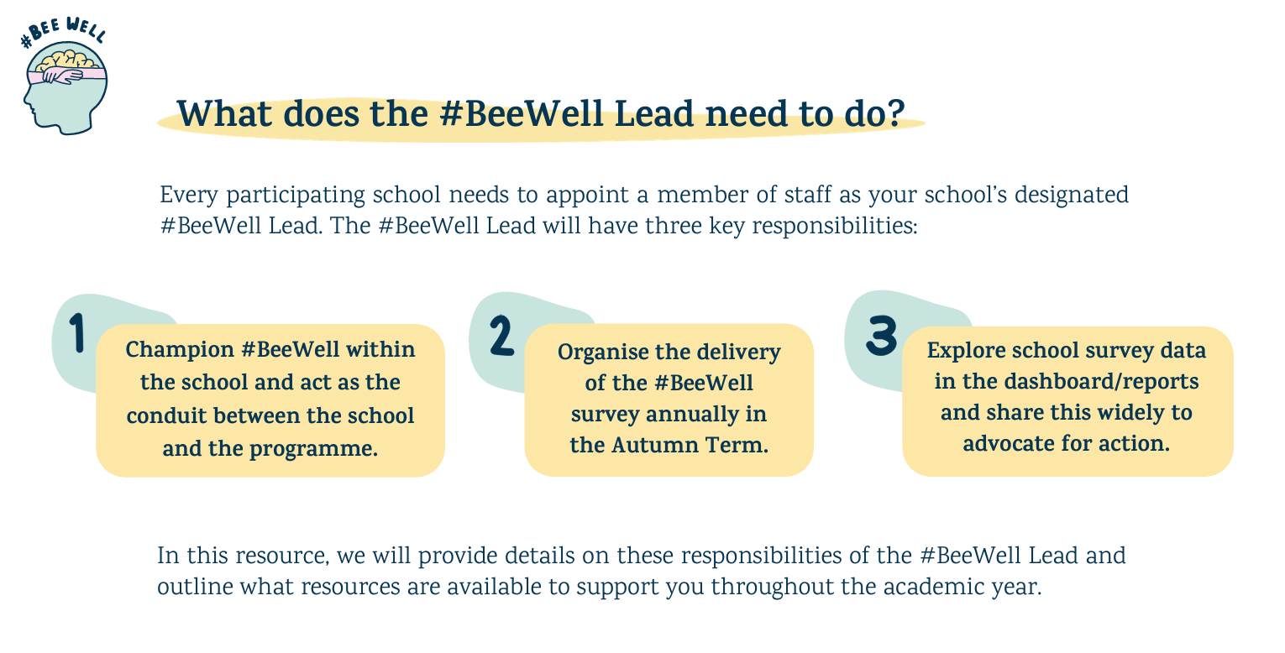

Slide 10
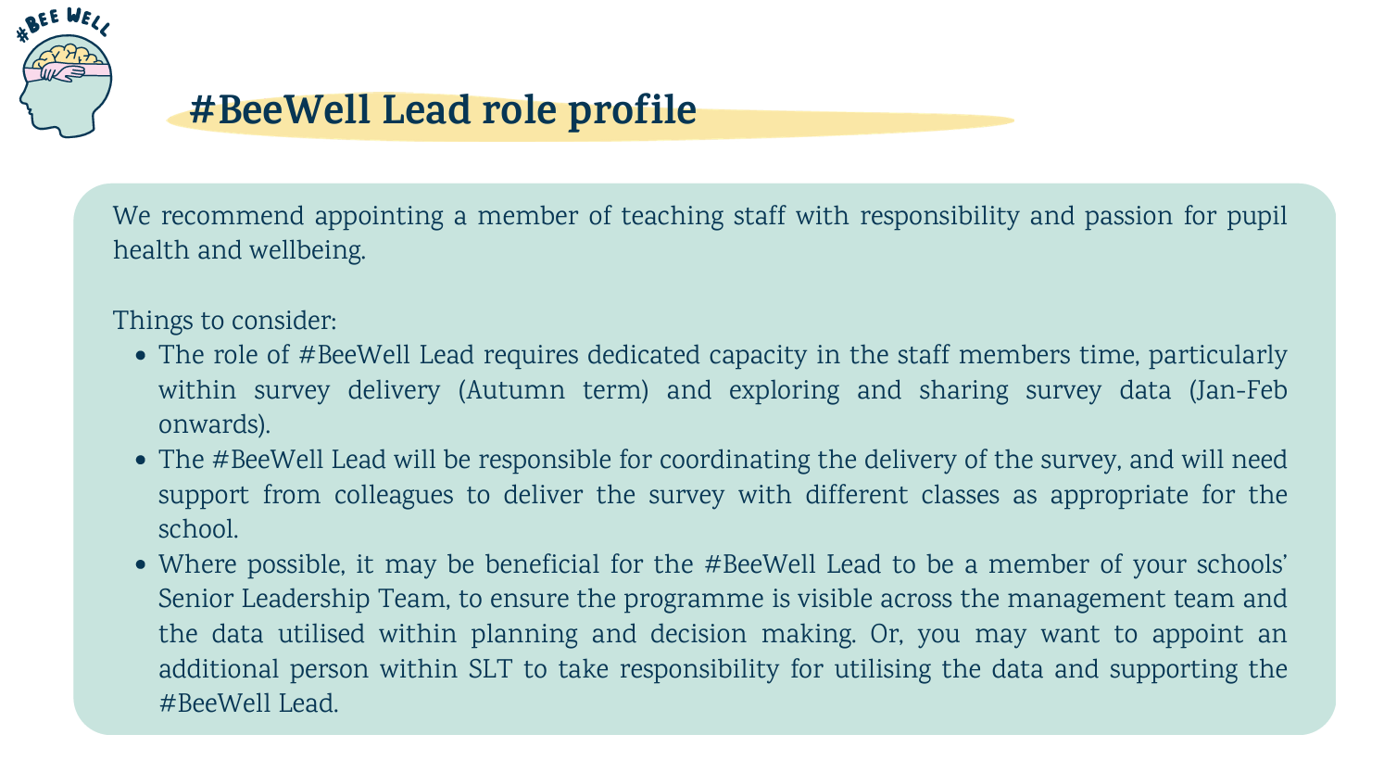

Slide 11
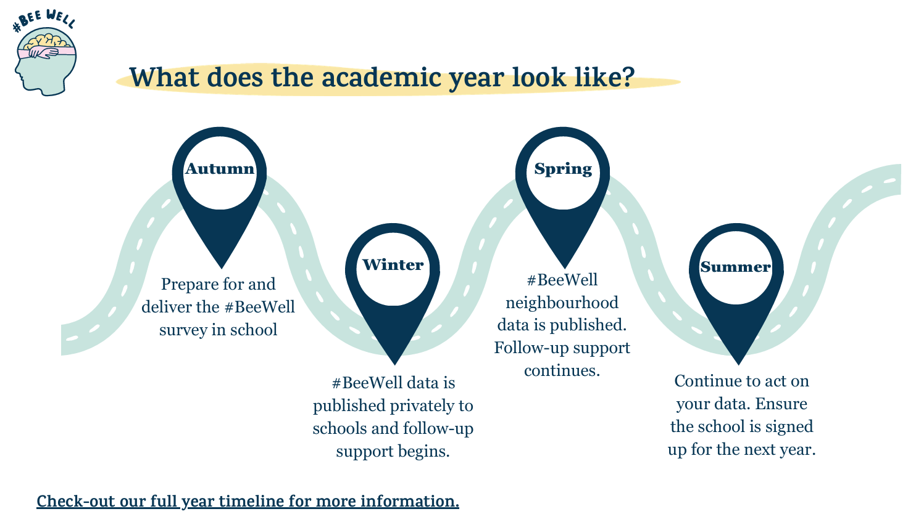

Slide 12
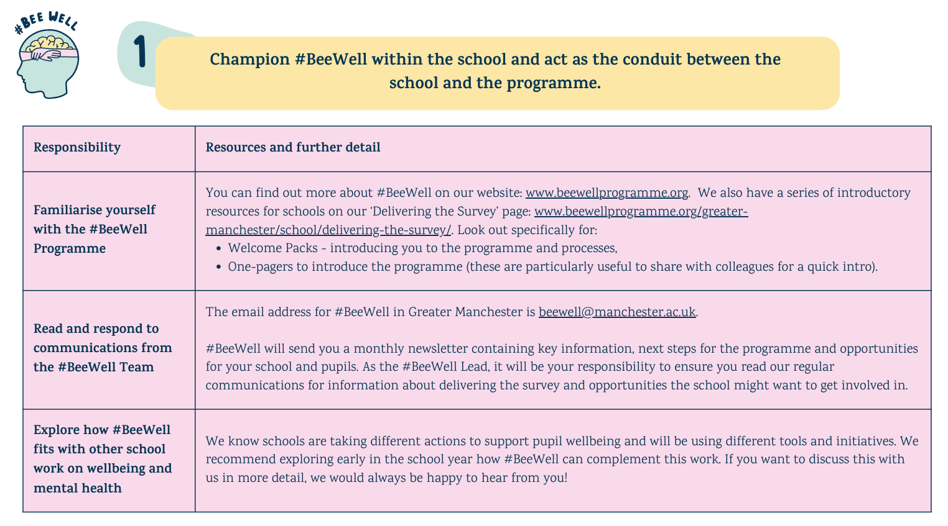

Slide 13
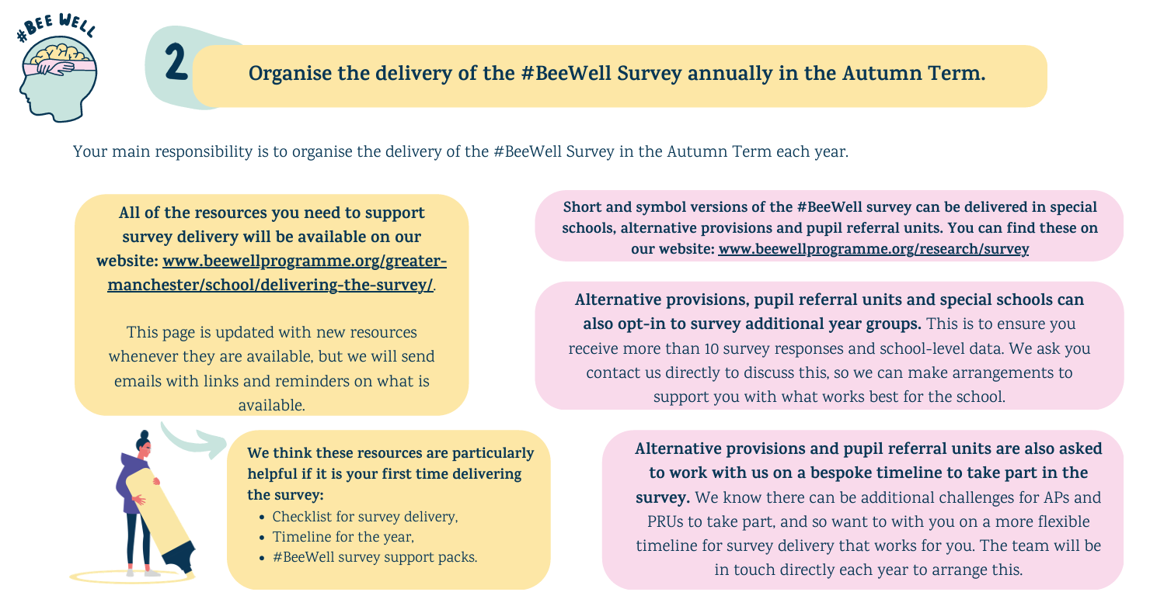

Slide 14
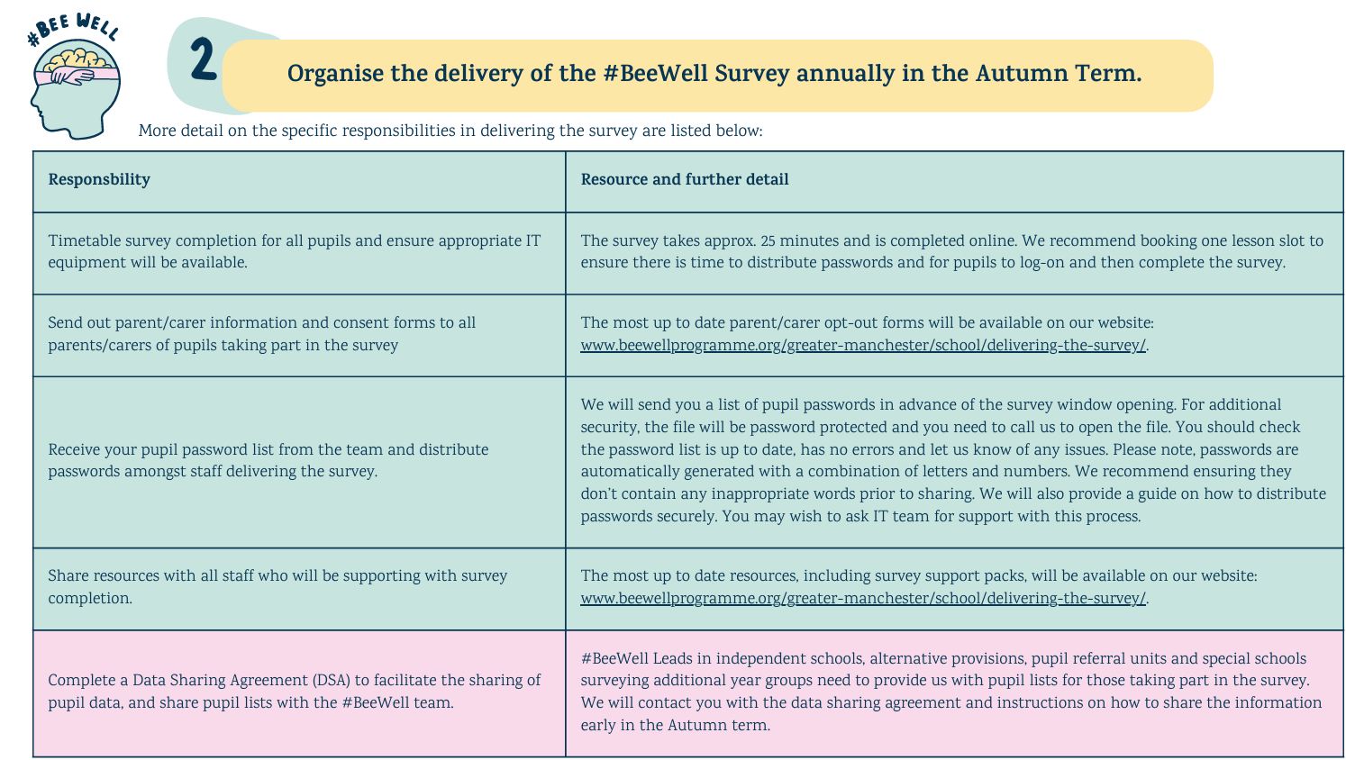

Slide 15
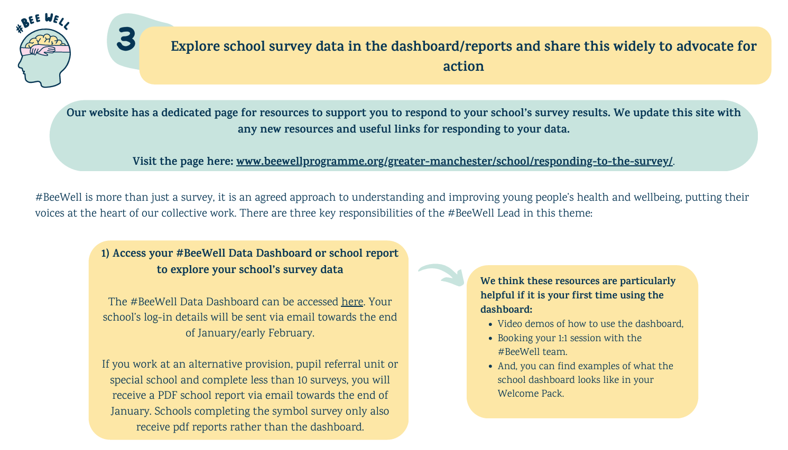

Slide 16
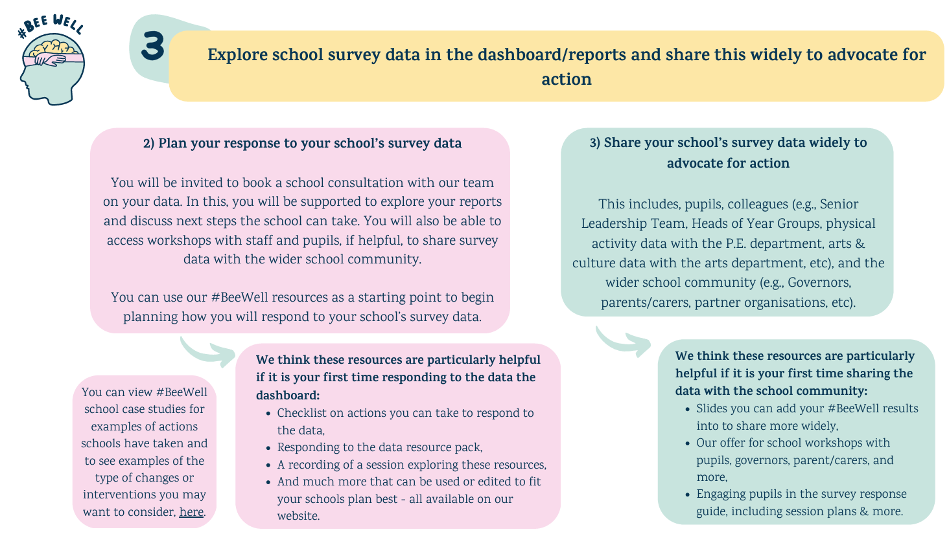

Slide 17
Next steps & timeline for 2026/27

Slide 18
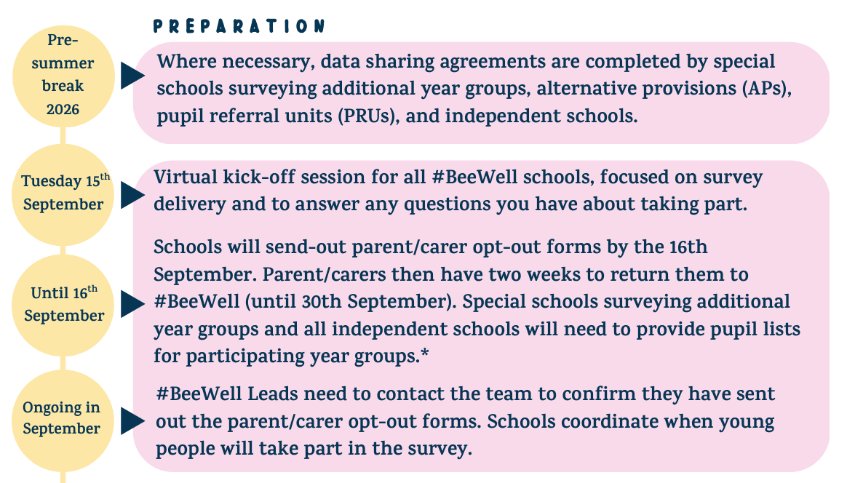

Slide 19
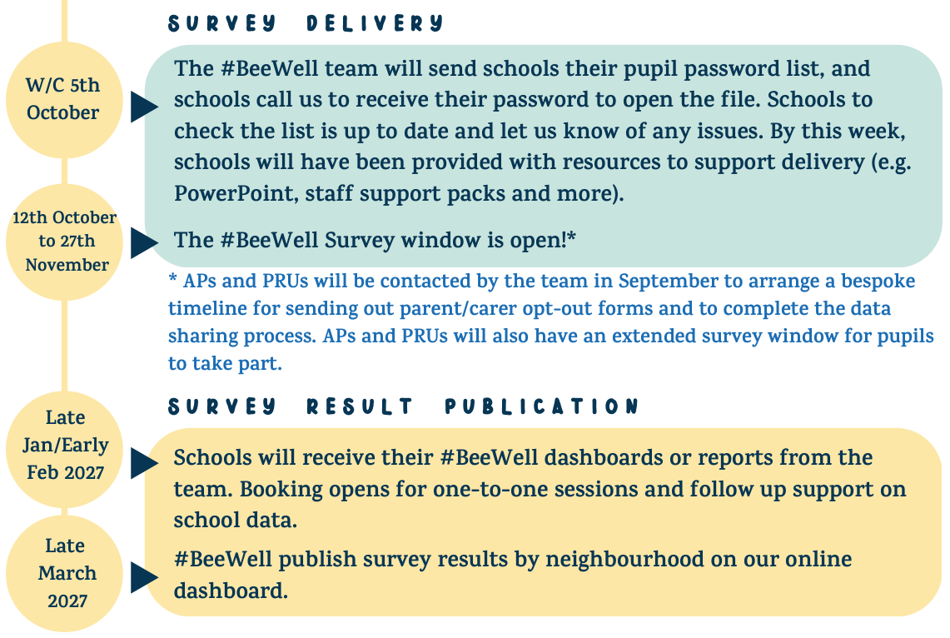

Slide 20
Bespoke timelines for alternative provisions and pupil referral units
We work directly with alternative provisions and pupil referral units on a timeline to take part that works for you to hear from as many pupils as you can, and that works within the school timeline.
Please contact us directly on when you would like to deliver the survey, and we'll help you work backwards to arrange data sharing and opt-out forms.
Remember APs and PRUs can take part up until 11th December 2026.

Slide 21
For special schools, alternative provisions and pupil referral units surveying additional year groups
You will need to send out bespoke versions of the #BeeWell opt-out forms to parent/carers of those taking part. Please make sure to let us know ASAP if you have not already, if you plan to survey additional year groups.

Slide 22
Summary – key next steps
Opt-out forms must be sent-out to parent/carers of Years 7, 9 and 10. The deadline to send these out so you can start surveying from 12th Oct is tomorrow, the 16th September. Parent/carers then have two weeks to opt-out their child. If you have already sent out the forms, please let us know by emailing beewell@manchester.ac.uk.
  If you can't send them out by tomorrow, let us know and we'll provide a form with a new deadline, but this will mean you have to start surveying later in the window.
Data sharing agreements and processes must be completed by special school surveying additional year groups, independent schools, alternative provisions and pupil referral units.
Pupil password lists will be sent from the w/c 5th Oct, you will need to call us for a password to open the file.
The survey window is 12th October to the 27th November.

Slide 23
What else is coming up from #BeeWell this year?
Funding opportunity for youth-led responses to the #BeeWell data, open until 20th October 2026: Applications open for our GM youth-led action fund! - #BeeWell.
We will continue our in-person #BeeWell Young Researchers Programme 2026/27 and have spaces for even more schools to get involved!
Refreshing the #BeeWell programme for our next phase, 2027-2030. Have your say on survey content and improvements for future delivery of #BeeWell.

Slide 24
Any questions?

Slide 25

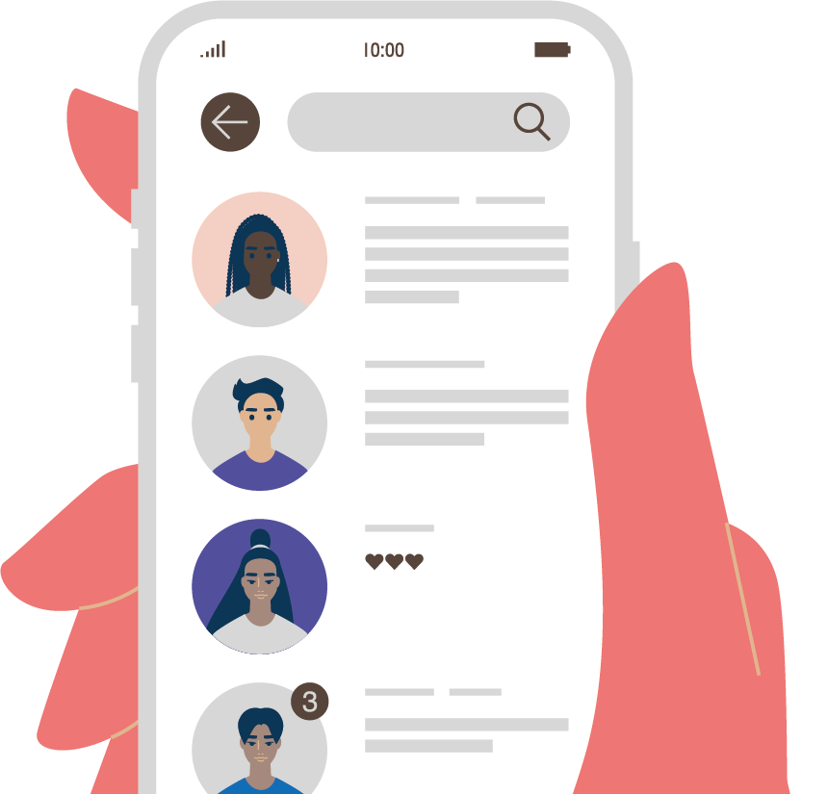
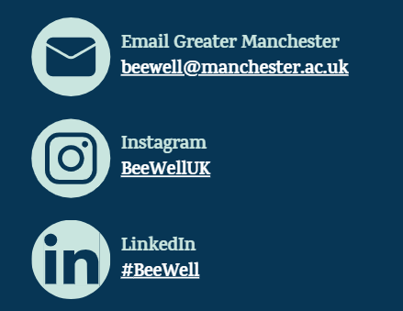
Thank you!

