Slide 1
Understanding your #BeeWell Data Hive
3rd February 2026

Slide 2

Agenda
Introducing the dashboard
Navigating the dashboard
Domains and drivers
Visual representations
Q&A
Follow up support
Keep in touch

Slide 3

Housekeeping
Do keep microphones muted unless you’re speaking
Do use raise your hand or use the chat to ask questions
The session will be recorded and shared with other schools and be available on the #BeeWell website.

Slide 4
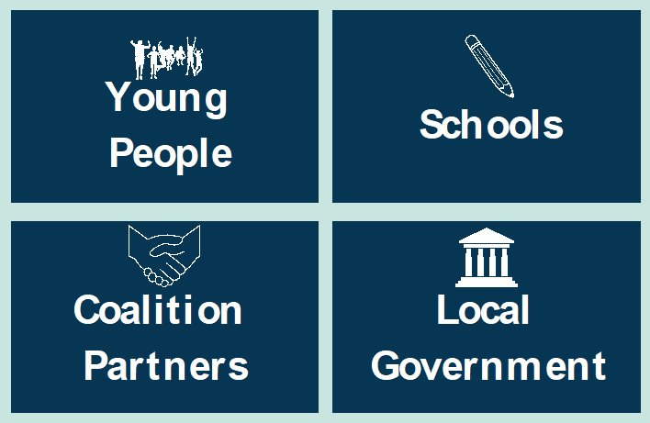
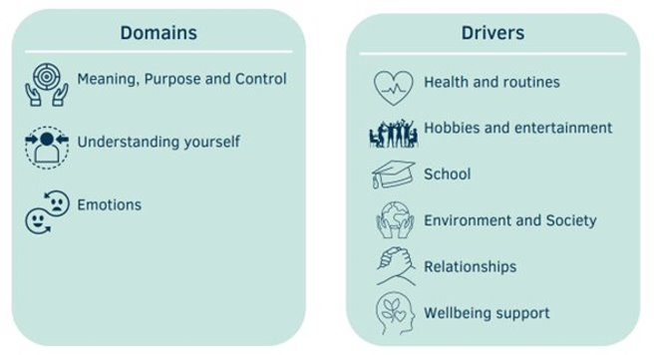
What is #BeeWell?
#BeeWell is a youth centred programme that measures young people's wellbeing annually through an online survey in secondary schools. Findings are published privately to school and publicly by neighbourhood.
Launched in Greater Manchester in 2019, the programme expanded into Hampshire, Isle of Wight, Portsmouth and Southampton (HIPS) in 2023. #BeeWell is a collaboration between University of Manchester and Anna Freud.
To date we have had over 63,800 responses to the survey and have worked with 119 schools.
The programme works with four key partners, to act on the results to improve wellbeing. Participating schools are offered 1:1 support in interpreting their findings.
The survey
The survey has been developed with 200 young people from 15 pathfinder schools across HIPS.
30% of the questions were tailored to fit local priorities, informed by young people’s feedback.
Young people in non-mainstream schools were able to complete a short version of the survey, these answers will form part of your dashboard.
If students in your school completed a symbol version of the survey, these findings will be shared with you via a PDF report.

Slide 5
Your dashboard – the #BeeWell Data Hive
The dashboard was designed with support from school leaders
The dashboard includes:
A particular focus on the domains and drivers that are priorities for schools
Signposting of results for your school’s ‘statistical neighbours’ within HIPS
Use of both intuitive data visualisations and data tables
The ability to explore data trends at different levels of granularity
The ability to compare, side by side, the scores of different groups for some measures

Slide 6
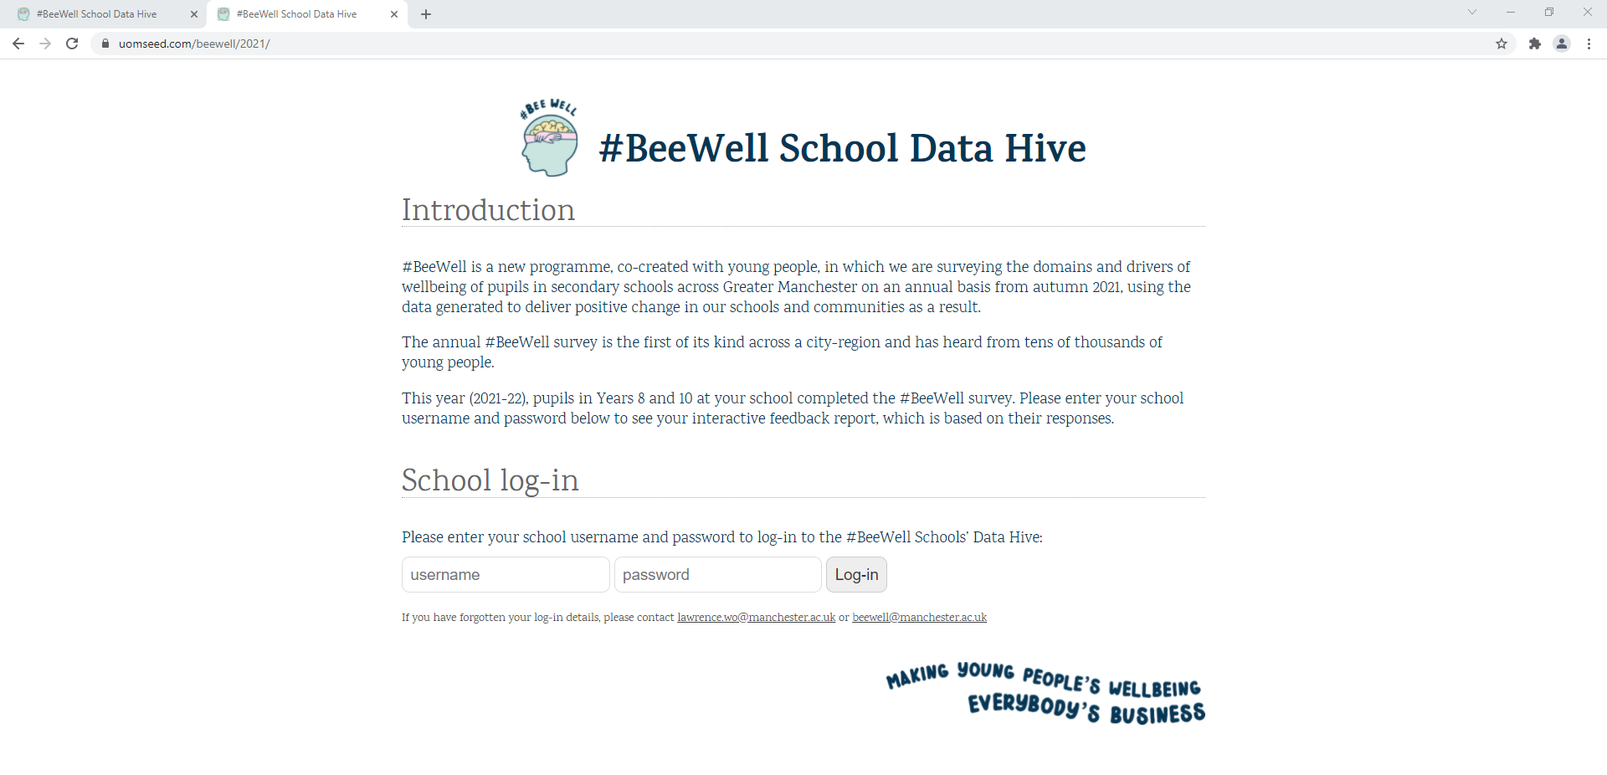
Accessing your report:
Requires log in and password which were sent to schools on 31st January 2025
If you’re having problems accessing your report contact hiow.beewell@hants.gov.uk

Slide 7
Book your 1:1 consultations now
Take the opportunity to explore your survey dashboard with a member of the Beewell team:
Up to 50mins
Explore the key findings
Discuss your interpretation of the findings
Discuss next steps
Book here:
https://outlook.office.com/book/BeeWell11SchoolConsultations2026@annafreud.org/?ismsaljsauthenabled
Notes:
https://outlook.office.com/book/BeeWell11SchoolConsultations2026@annafreud.org/?ismsaljsauthenabled

Slide 8

Questions

